Slide 1

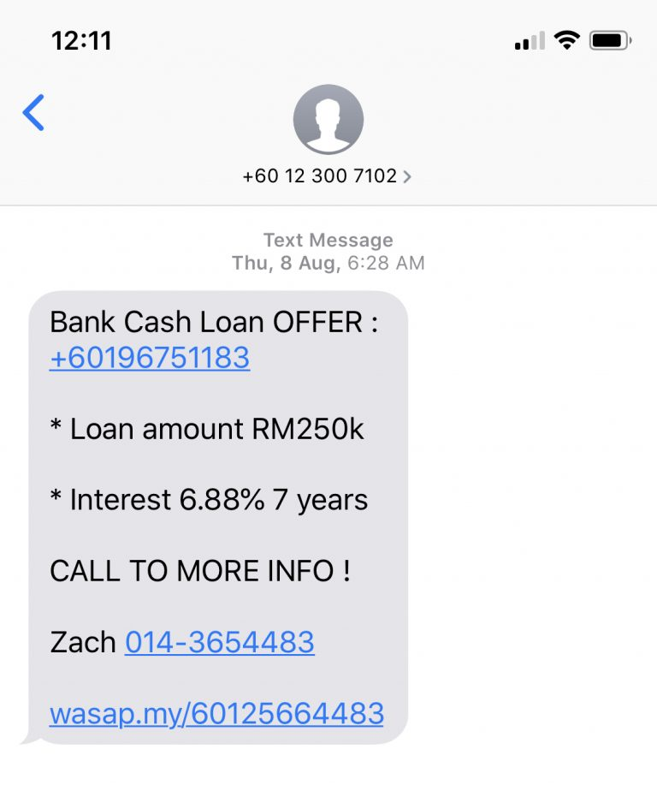
SMS Spam Collection
By: Ling Hsiu Ann Karen

Slide 2

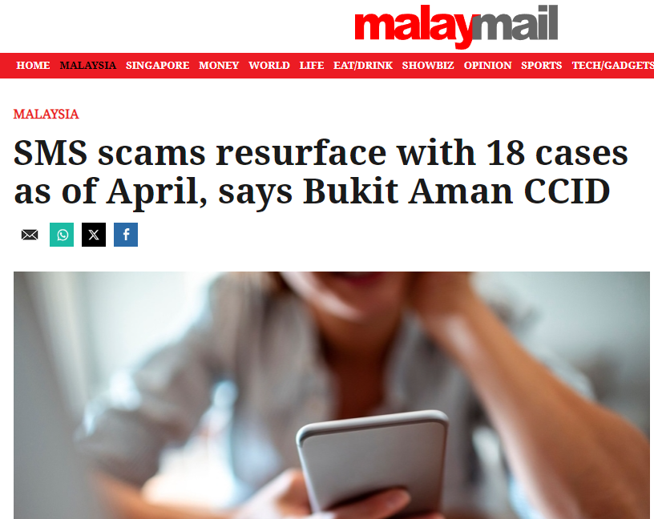
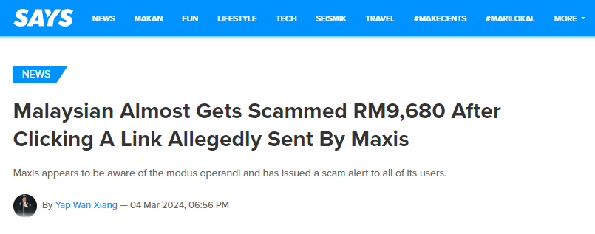
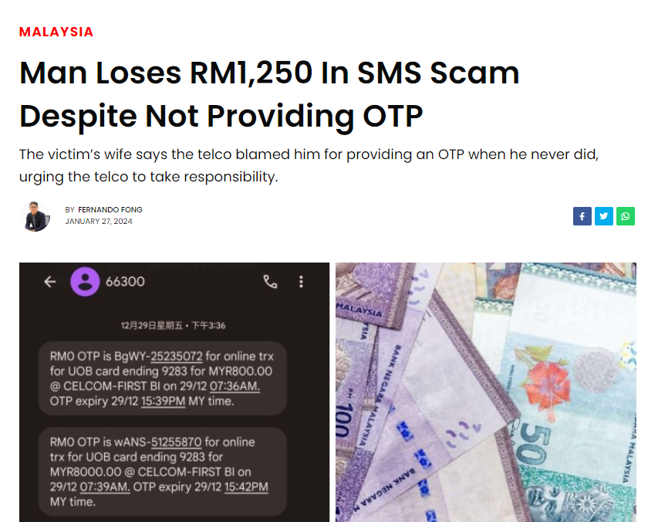
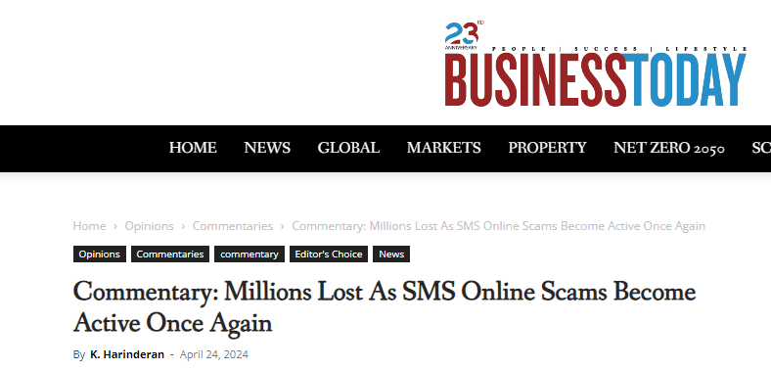
Privacy Invasion
Security Risks
Financial Loss

Slide 3
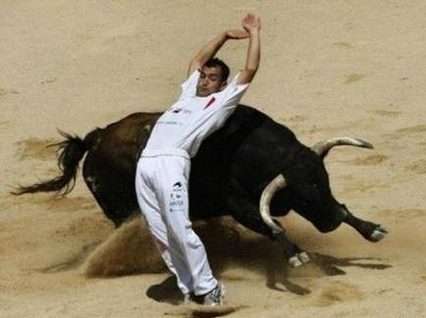

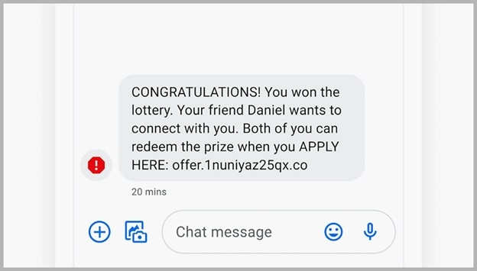

Real-time spam detection system that can analyze incoming SMS messages
EVERYONE
SPAM SMS

Slide 4
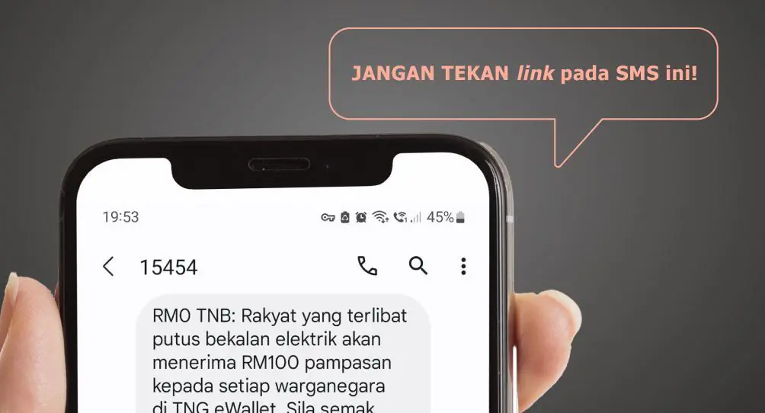
Improve user experience
Enhance security
Reduce spam-related issues

Slide 5
CLICK HERE TO END PRESENTATION
http://dontclicksuspiciouslinks.com

Slide 6
REFERENCES
Xiang, Y. W. (2024, March 4). Malaysian Almost Gets Scammed RM9,680 After Clicking A Link Allegedly Sent By Maxis. SAYS. https://says.com/my/news/malaysian-nearly-scammed-rm9680-clicking-link-maxis-allegedly-sent
Mail, M. (2024, April 19). SMS scams resurface with 18 cases as of April, says Bukit Aman CCID. Malay Mail ; Malay Mail. https://www.malaymail.com/news/malaysia/2024/04/19/sms-scams-resurface-with-18-cases-as-of-april-says-bukit-aman-ccid/129746
‌Harinderan, K. (2024, April 24). Commentary: Millions Lost As SMS Online Scams Become Active Once Again - BusinessToday. Https://Www.businesstoday.com.my/. https://www.businesstoday.com.my/2024/04/24/commentary-millions-lost-as-sms-online-scams-become-active-once-again/
Jha, N. (2024, May 3). SMS Spam: Hidden Costs & SMS Firewall Solutions. Broadbandtele.net. https://www.broadbandtele.net/blog/hidden-cost-of-sms-spam-need-for-sms-firewall/

